Slide 1

Feasibility of a Loop 20
Transportation Reinvestment Zones
November 7, 2022
Prepared By

Slide 2
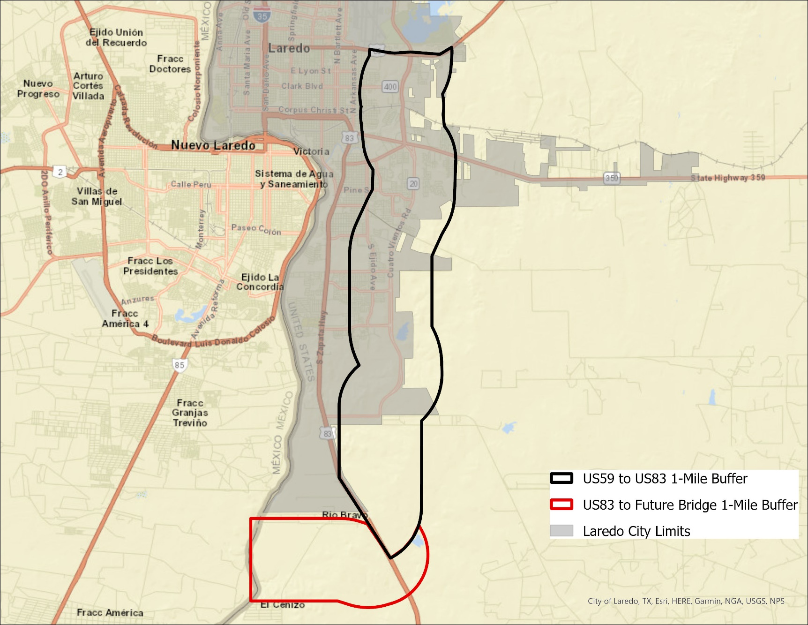
Loop 20 TRZ Analysis – Study Area

Slide 3
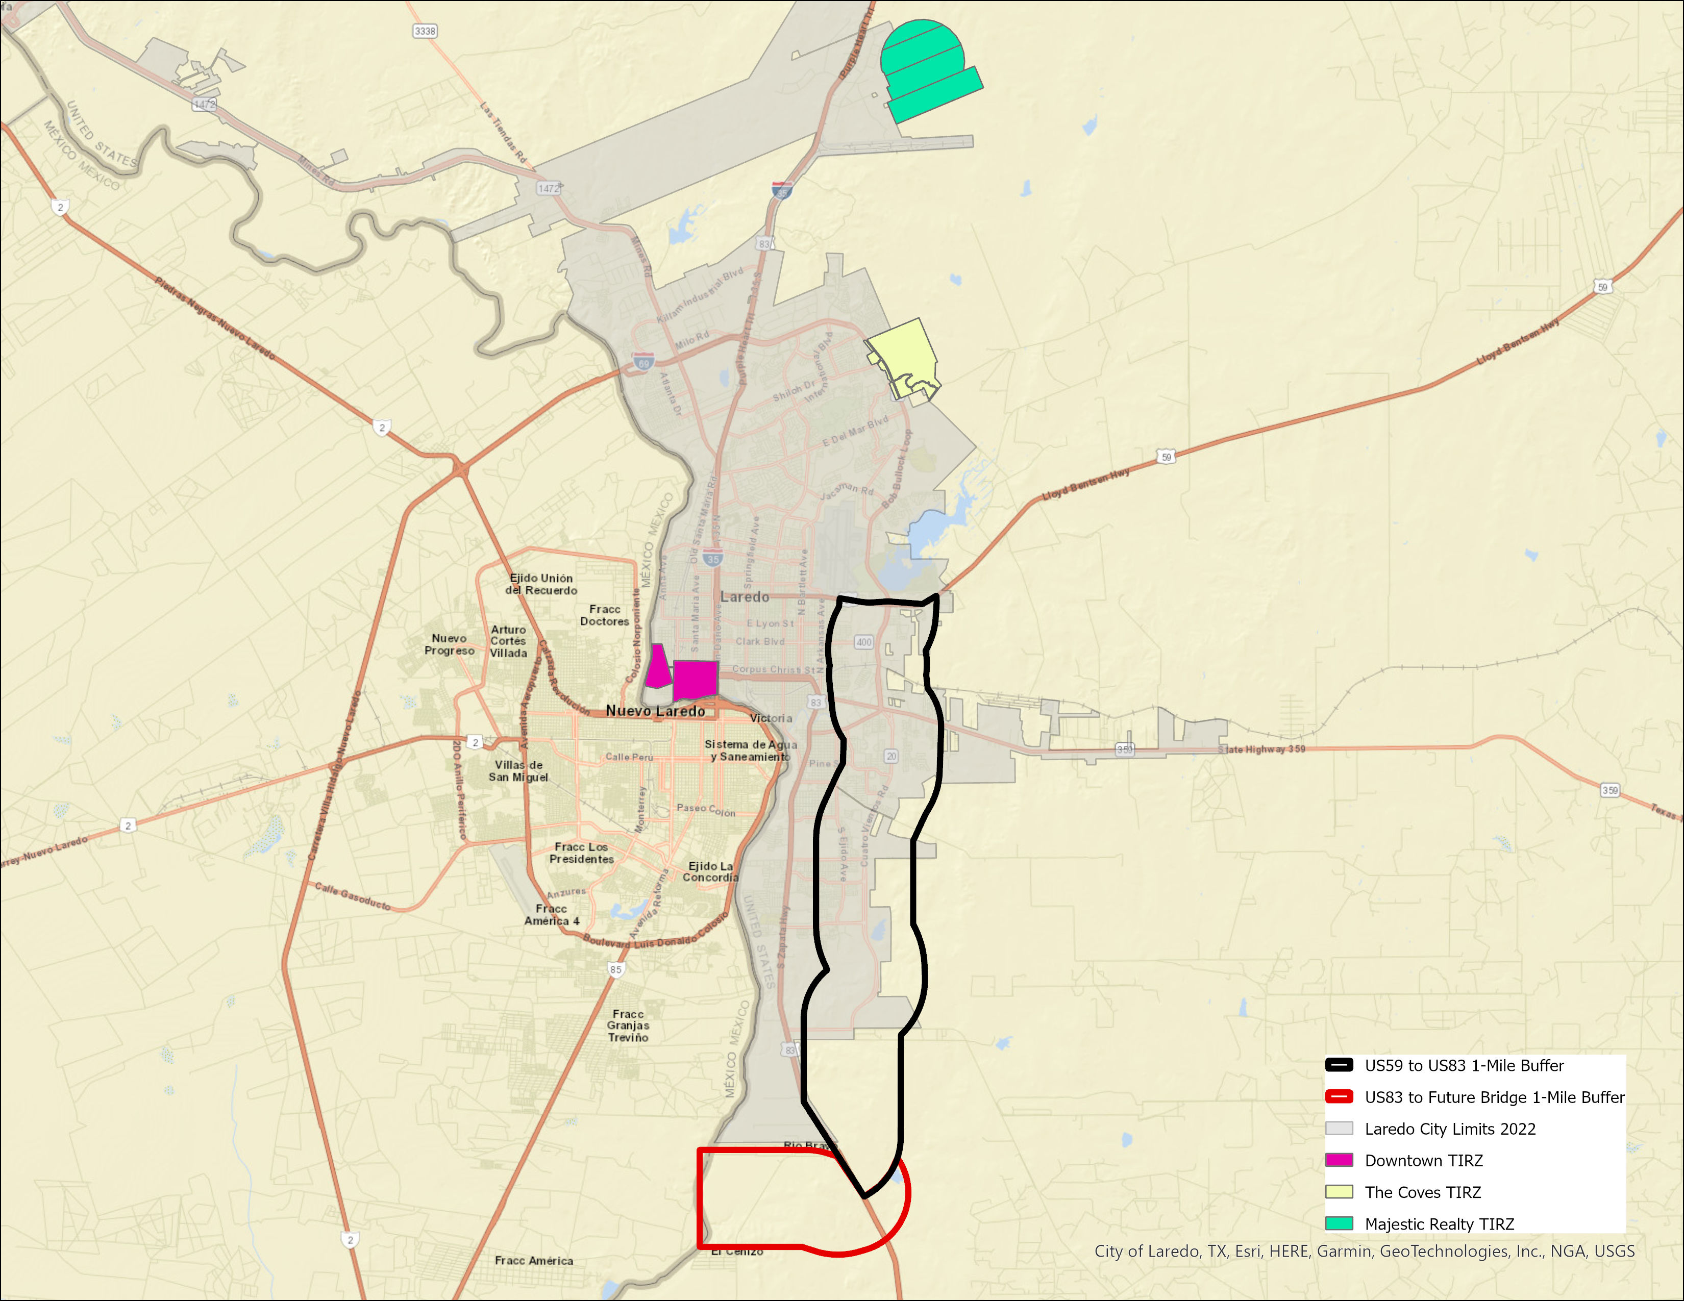
Existing TIRZ in Laredo

Slide 4
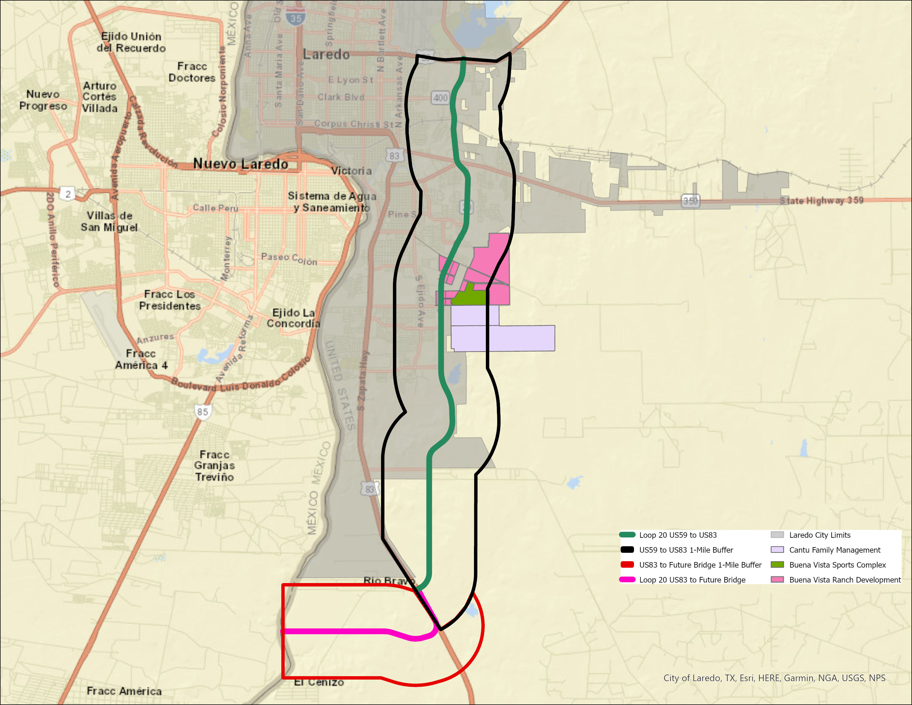
Loop 20 TRZ Analysis – Developments

Slide 5
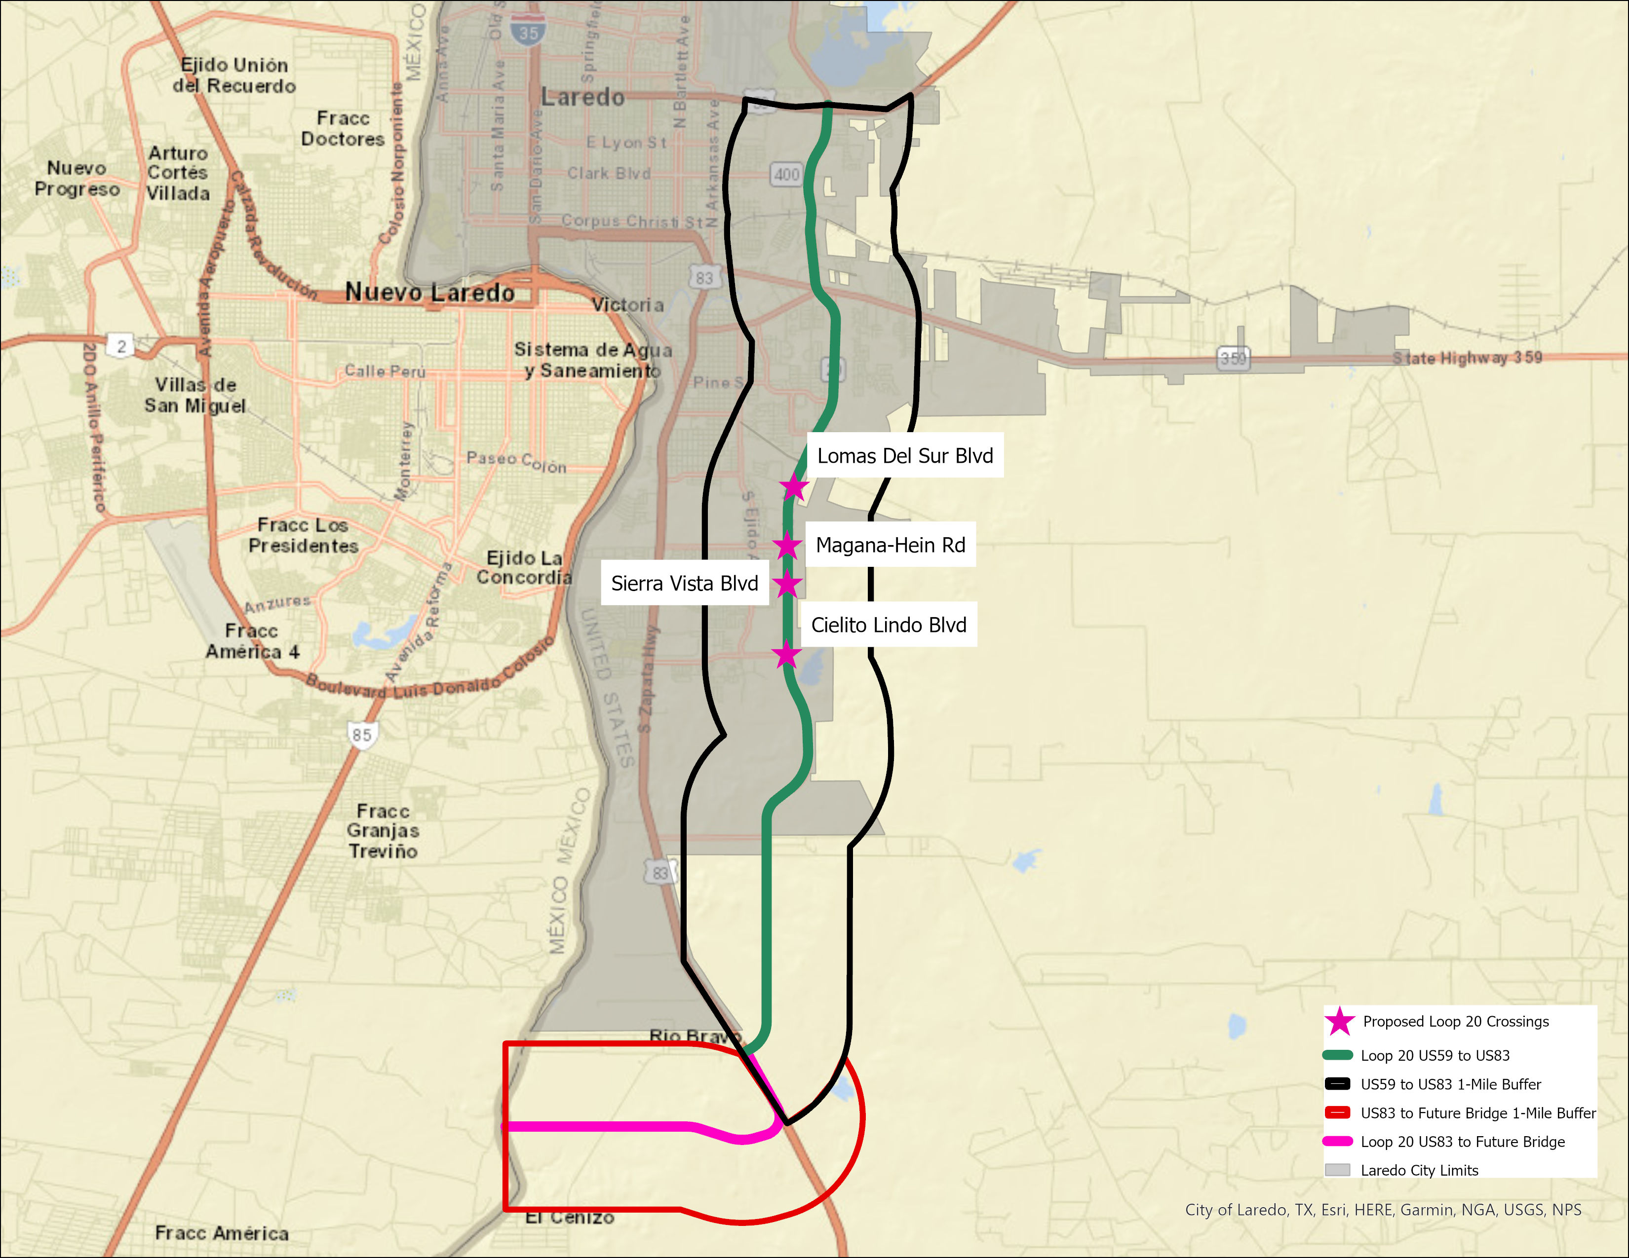
Preliminary Location of Crossings

Slide 6
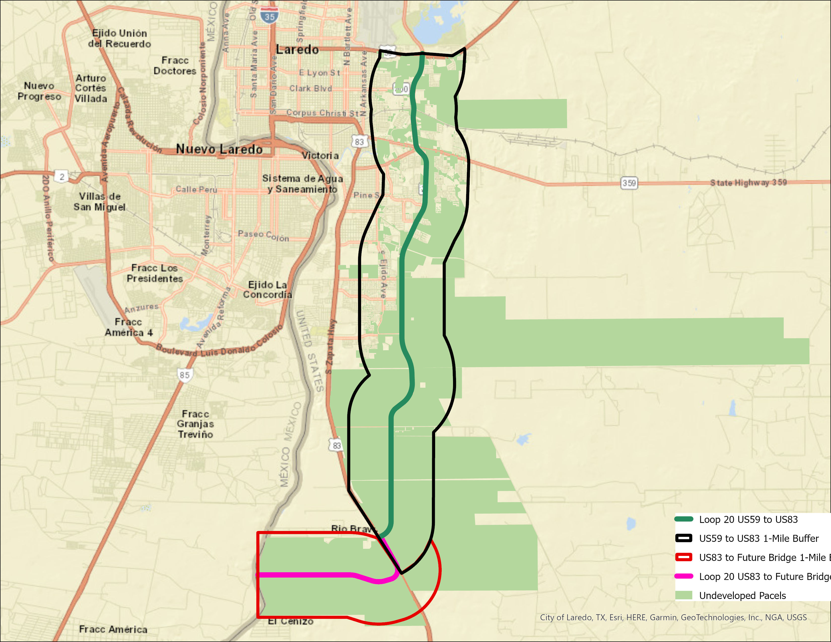
Loop 20 TRZ Analysis – Undeveloped

Slide 7
Loop 20 Tax – What has Changed?
Tax rates have declined as property values have increased
Home prices in Study Area have increased substantially
  2017 = $125,000
  2022 = $200,000
New master planned developments along Loop 20 will continue to increase traffic
How will higher interest rates impact demand?

Slide 8
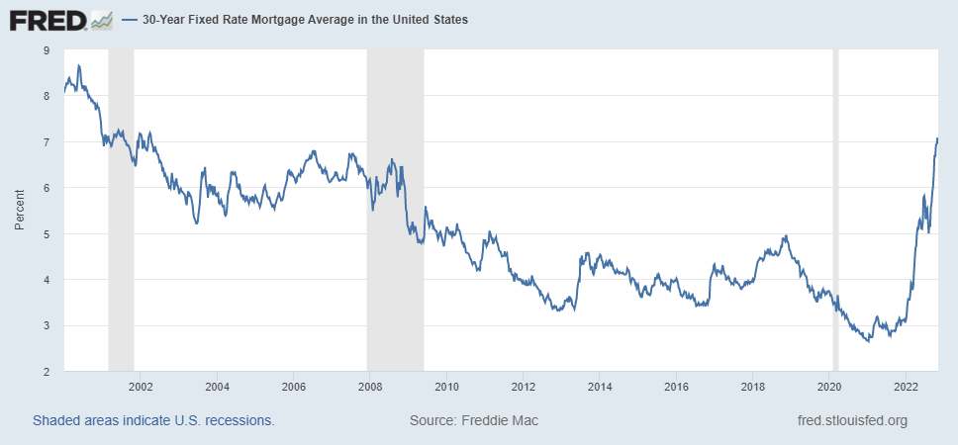
30-Year Fixed Mortgage Average

Slide 9
Loop 20 Tax Assumptions
The 2023 property tax rates remained constant
  City of Laredo - $0.57
  Webb County - $0.39
5.0% discount rate was used for the net present value (NPV) calculations.
3.0% percent appreciation rate was used for residential and commercial values.
The 2022 baseline value for the Loop 20 TRZ is $2.2 billion.
TXP assumed no appreciation of the 2022 baseline in any forecast scenario.
Development around the proposed Bridge #5 would begin in 2032. TXP modeled development around Bridge #5 based on the Vallecillo Road TRZ analysis.
Taxable value of commercial + industrial real property per worker of $55,388 ($2022).

Slide 10
Loop 20 Tax Revenue Scenarios
Scenario 1 uses the most recent five-year pattern of residential building permits (300 per year) within the TRZ buffer area to project household growth. TXP held the countywide ratio of population to employment constant for 30 years.
Scenario 2 combines the Laredo MPO TAZ forecast data with estimated home value based on stakeholder feedback. The consensus was south Laredo would begin attracting a more expensive housing product than in the past. This scenario assumes a new home is taxed at $200,000 ($2022).
Scenario 3 uses the TXDOT Travel Demand Model. This model has lower growth through 2045. The starting residential value for new units is based on the existing 2022 average value of roughly $129,100 for the buffer area (house plus land). This reflects uncertainty over how many mobile home units will be attracted to this area.

Slide 11
30 Year Tax Revenue
City of Laredo + Webb County
 | 10% Allocation | 20% Allocation | 30% Allocation | 40% Allocation | 50% Allocation
Scenario 1
Laredo | $39,549,655 | $79,099,311 | $118,648,966 | $158,198,622 | $197,748,277
Webb | $26,366,437 | $52,732,874 | $79,099,311 | $105,465,748 | $131,832,185
Scenario 2
Laredo | $70,936,281 | $141,872,563 | $212,808,844 | $283,745,125 | $354,681,407
Webb | $47,290,854 | $94,581,708 | $141,872,563 | $189,163,417 | $236,454,271
Scenario 3
Laredo | $58,221,897 | $116,443,794 | $174,665,692 | $232,887,589 | $291,109,486
Webb | $38,814,598 | $77,629,196 | $116,443,794 | $155,258,393 | $194,072,991

Slide 12
Loop 20 TRZ Analysis
Questions

